Slide 1

PRESENTATION ON PROJECT
UNIVERSITY INSTITUTE OF TECHNOLOGY RGPV, BHOPAL(M.P.)
Virtual Assistance
Presented By: Sumit Kumar Soni
Enroll. : 0101CA201031
MCA 4th Semester

Slide 2
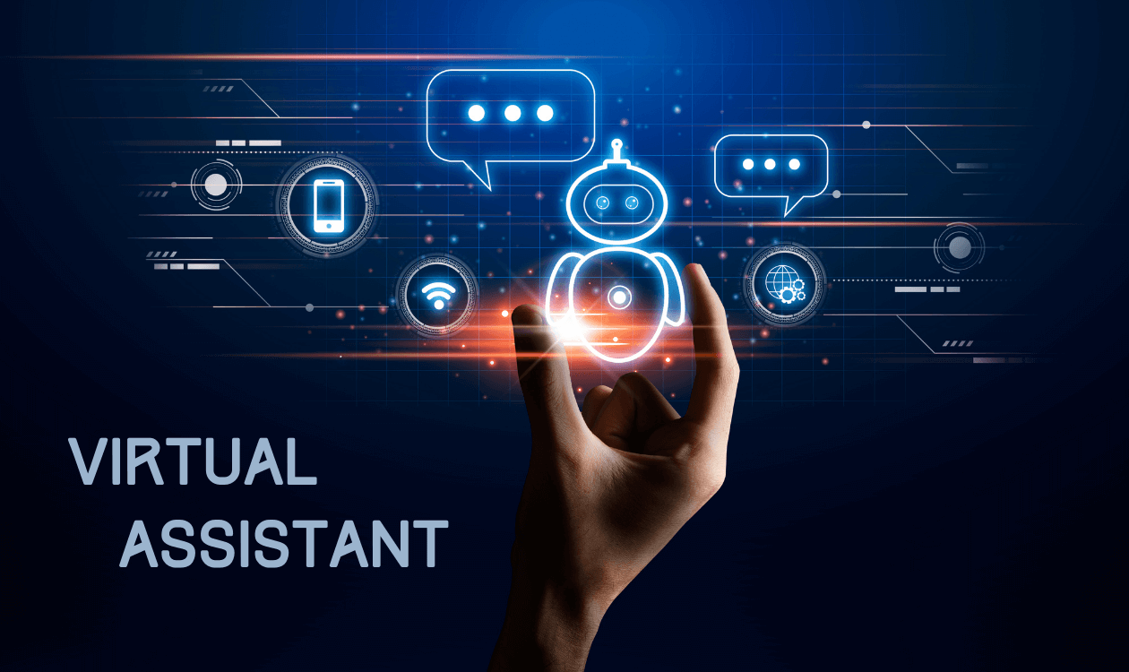

Slide 3
Content
About Project
Modules in Project
Software and Hardware specification
Designing
Data Flow Diagram
Methodology of Virtual Assistant Using Python
Implementation
Snapshots
Technologies Used
Conclusion & Future Work

Slide 4
Introduction
A virtual assistant is an application that understands voice commands and completes tasks for a user. Virtual assistants are available on most smartphones and tablets, traditional computers, and even standalone devices like the Amazon Echo and Google Home.

Slide 5
Modules
Voice Assistance

Slide 6
Software and Hardware specification
Software specification
AMD Ryzen 3 3250U with Radeon Graphics
At least 8 GB RAM
Hardware specification
Python 3, PyCharm , Visual Studio Code
Anaconda Distribution
Jupyter Notebook
Operating System Window 7 and above
Web browser ( Chrome, I.E 8 and above, Firefox, Safari etc.)

Slide 7
OBJECTIVE AND PURPOSE
Voice control, also called voice assistance, is a user interface that allows hands-free operation of a digital device. Voice control does not require an internet connection to work. Communication is one way (person to device) and all processing is done locally.
Voice assistants are devices/apps that use voice recognition technology, natural language processing, and AI to respond to humans. Using the technology, the device synthesizes the user's message, breaks it down, evaluates it, and offers a meaningful response in return.

Slide 8
Data Flow Diagram
Virtual
Assistance
Send Request
USER
Receives Responses

Slide 9
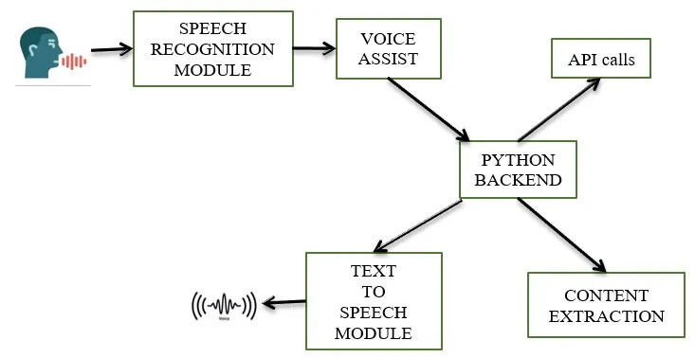
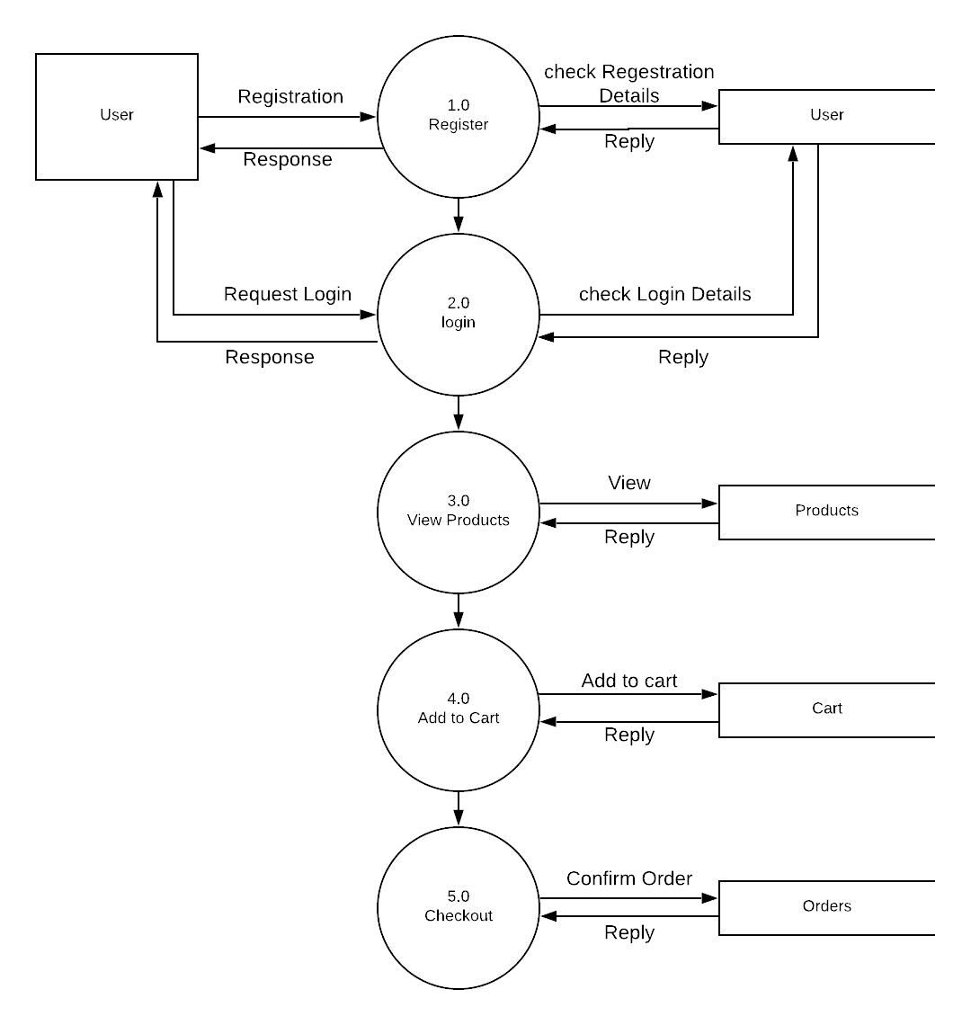
Methodology of Virtual Assistant Using Python
Users
Login
Users
Register
Select Location
Location
Select Services
Services
Checkout
Checkout

Slide 10
SCREENSHOTS
User Views

Slide 11
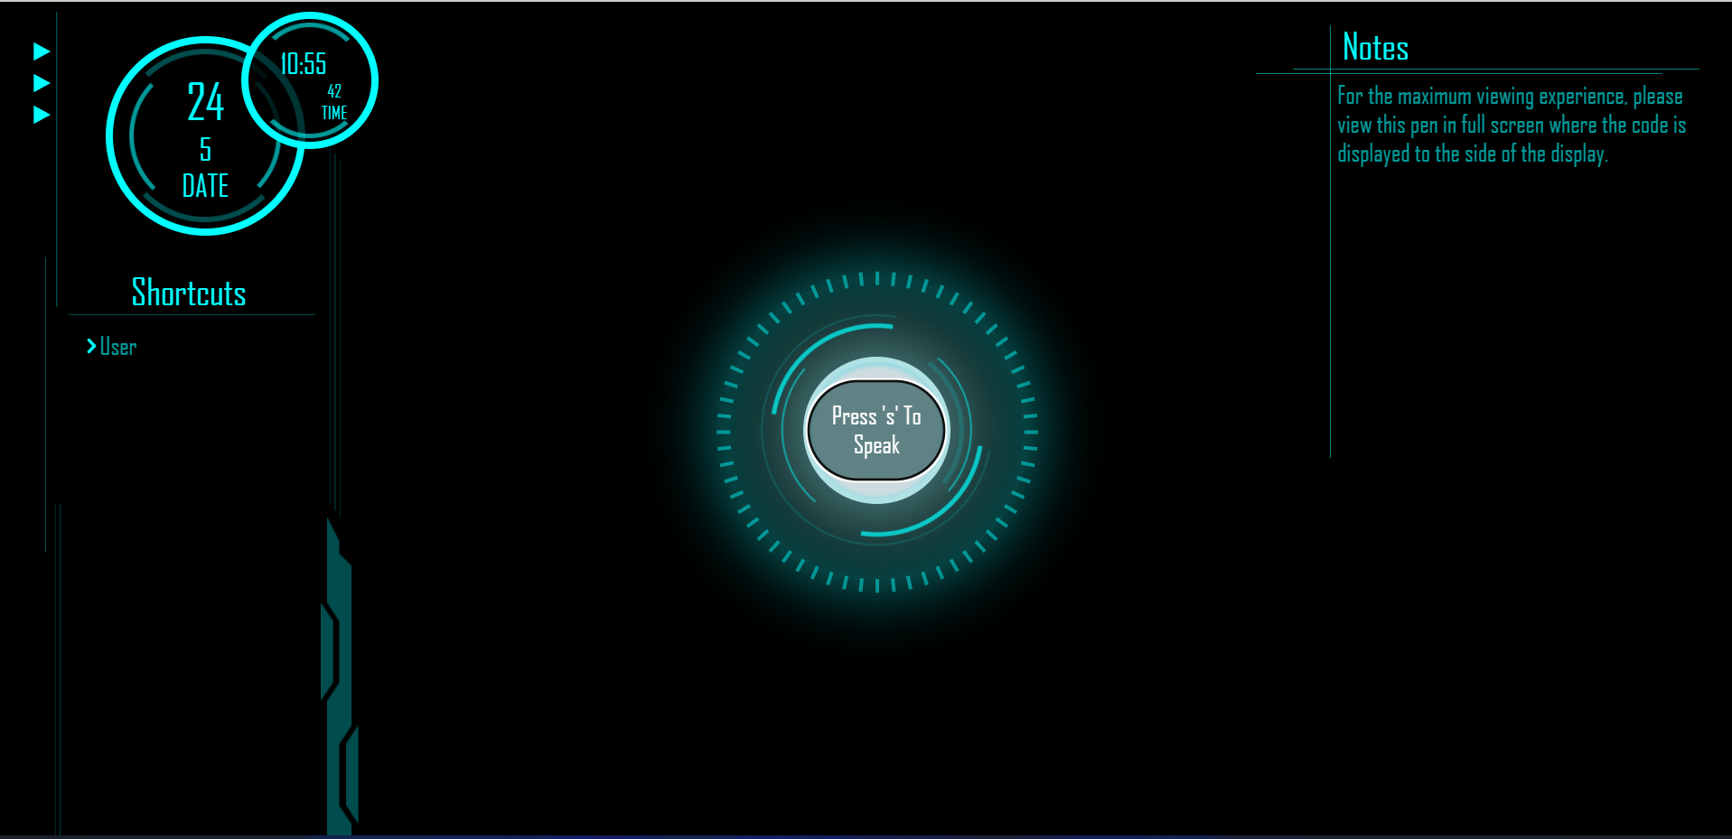
Input / Output Screen

Slide 12
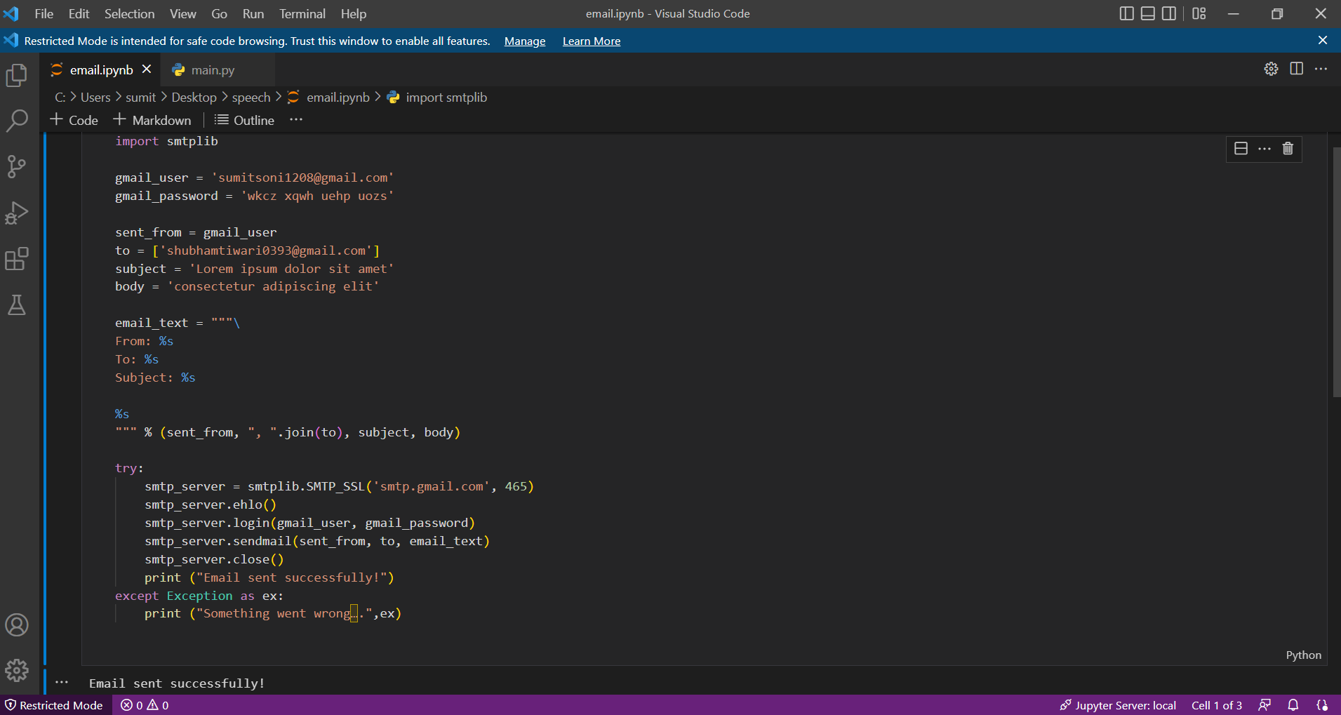
Email Sent

Slide 13
TECHNOLOGY USED
Front-End
PHP
HTML
CSS
Back-End
PYTHON
SQL
JAVA SCRIPT

Slide 14
LIMITATIONS
Only System Work
Slow Process.

Slide 15
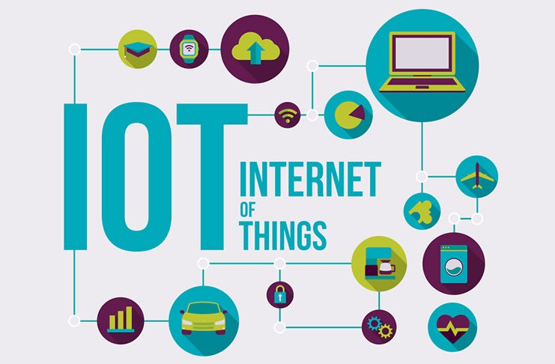
FUTURE ENHANCEMENT
IOT

Slide 16
IOT
Internet of Things, refers to the collective network of connected devices and the technology that facilitates communication between devices and the cloud, as well as between the devices themselves.

Slide 17
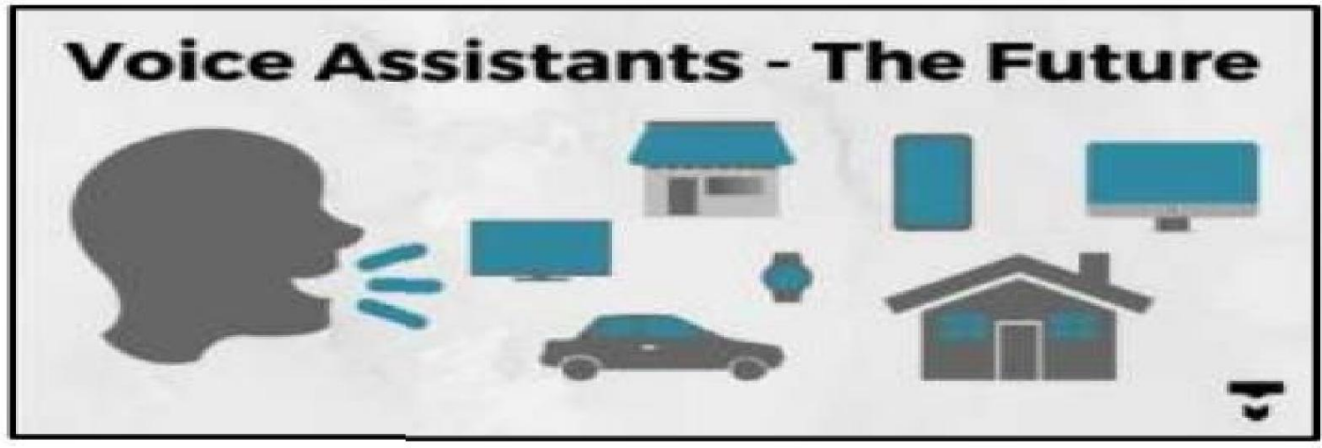
THE VOICE ASSISTANCE FUTURE

Slide 18
CONCLUSION
AI virtual assistants are evolving quickly. Companies are enabling them to provide more capabilities like speech recognition and natural language processing advances. It will enable them to understand and perform requests.

Slide 19
THANKING YOU

